Slide 1
Introduction to the Arduino
Ryan Brock

Slide 2
About Me
Ryan Brock
Software Engineer – 14 Years
Purdue University – Computer Science
Motorola
Zebra Technologies

Slide 3
Contact
Twitter: @borq79
Email: borq79@gmail.com
Github Repo:
https://github.com/borq79/Cary-Area-Public-Library-Classes

Slide 4
Agenda
Intro (5 Minutes)
Quick Basics (15 Minutes)
Project 1 (15 Minutes)
Bring and LED to life
So What Just Happened? (15 Minutes)
Basic Circuit
What is an LED
Voltage / Current / Resistance
Project 2 (20 Minutes)
Introducing a button into the circuit
Project 3 (15 Minutes)
Reading the Temperature of the Room
Project 4 (25 Minutes)
Multicolor LEDs

Slide 5
Your Kits
$55 Vilros Ultimate Starter Kit
https://www.vilros.com/ultimate-starter-kit.html
$3 DHT11 Humidity and Temperature Sensor
http://www.dxsoul.com/product/arduino-digital-temperature-humidity-sensor-module-901121350#.V0IP45MrJMP
$8 LED Strip
http://www.amazon.com/NulSom-NeoPixel-Rainbow-Stick-Arduino/dp/B00PTEP14W/ref=sr_1_1?ie=UTF8&qid=1452991973&sr=8-1&keywords=neopixel+stick
$3 20 pc. Capacitor Pack
http://www.dx.com/p/16v-1000uf-aluminum-motherboard-capacitors-20-piece-pack-127865#.V0IQv5MrJMM

Slide 6
Breadboard
Where is C:19?

Slide 7

Just Like Battleship

Slide 8
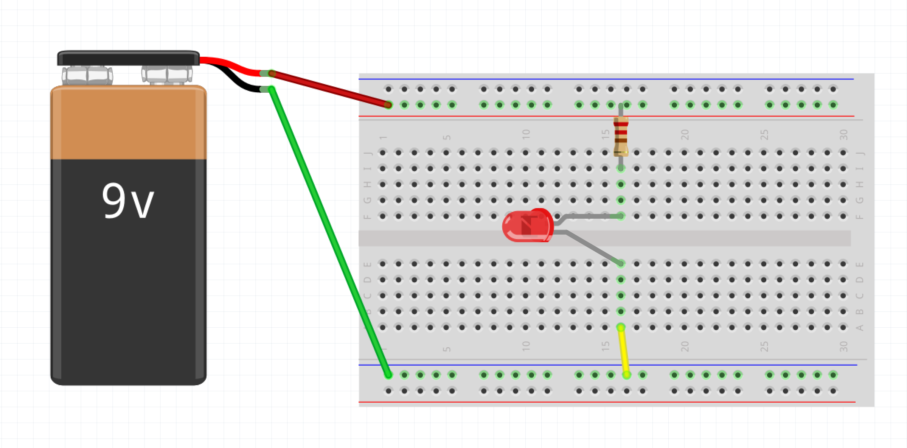
Wiring up a Circuit

Slide 9
Project 1 Parts List
Arduino
Breadboard
USB Cable
3 Male-Male wires
1 330 Ohm resistor
1 LED

Slide 10
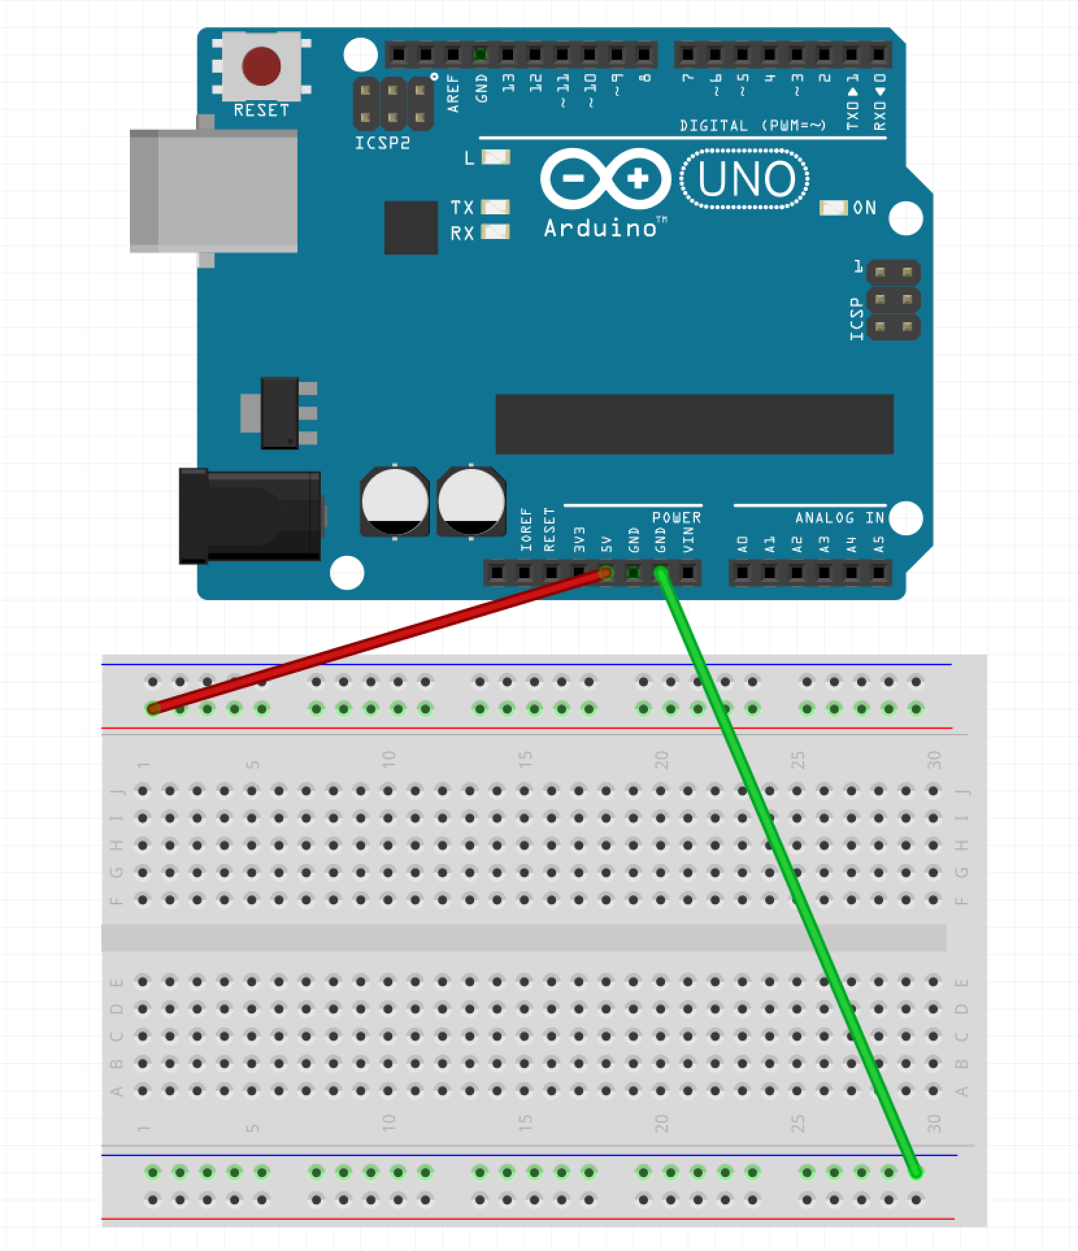
Step 1 – Wire up the Rails
Run wire from GND pin on Arduino to Blue Row on Breadboard (green wire in example)
Run wire from 5V pin on Arduino to Red Row on Breadboard (red wire in example)

Slide 11
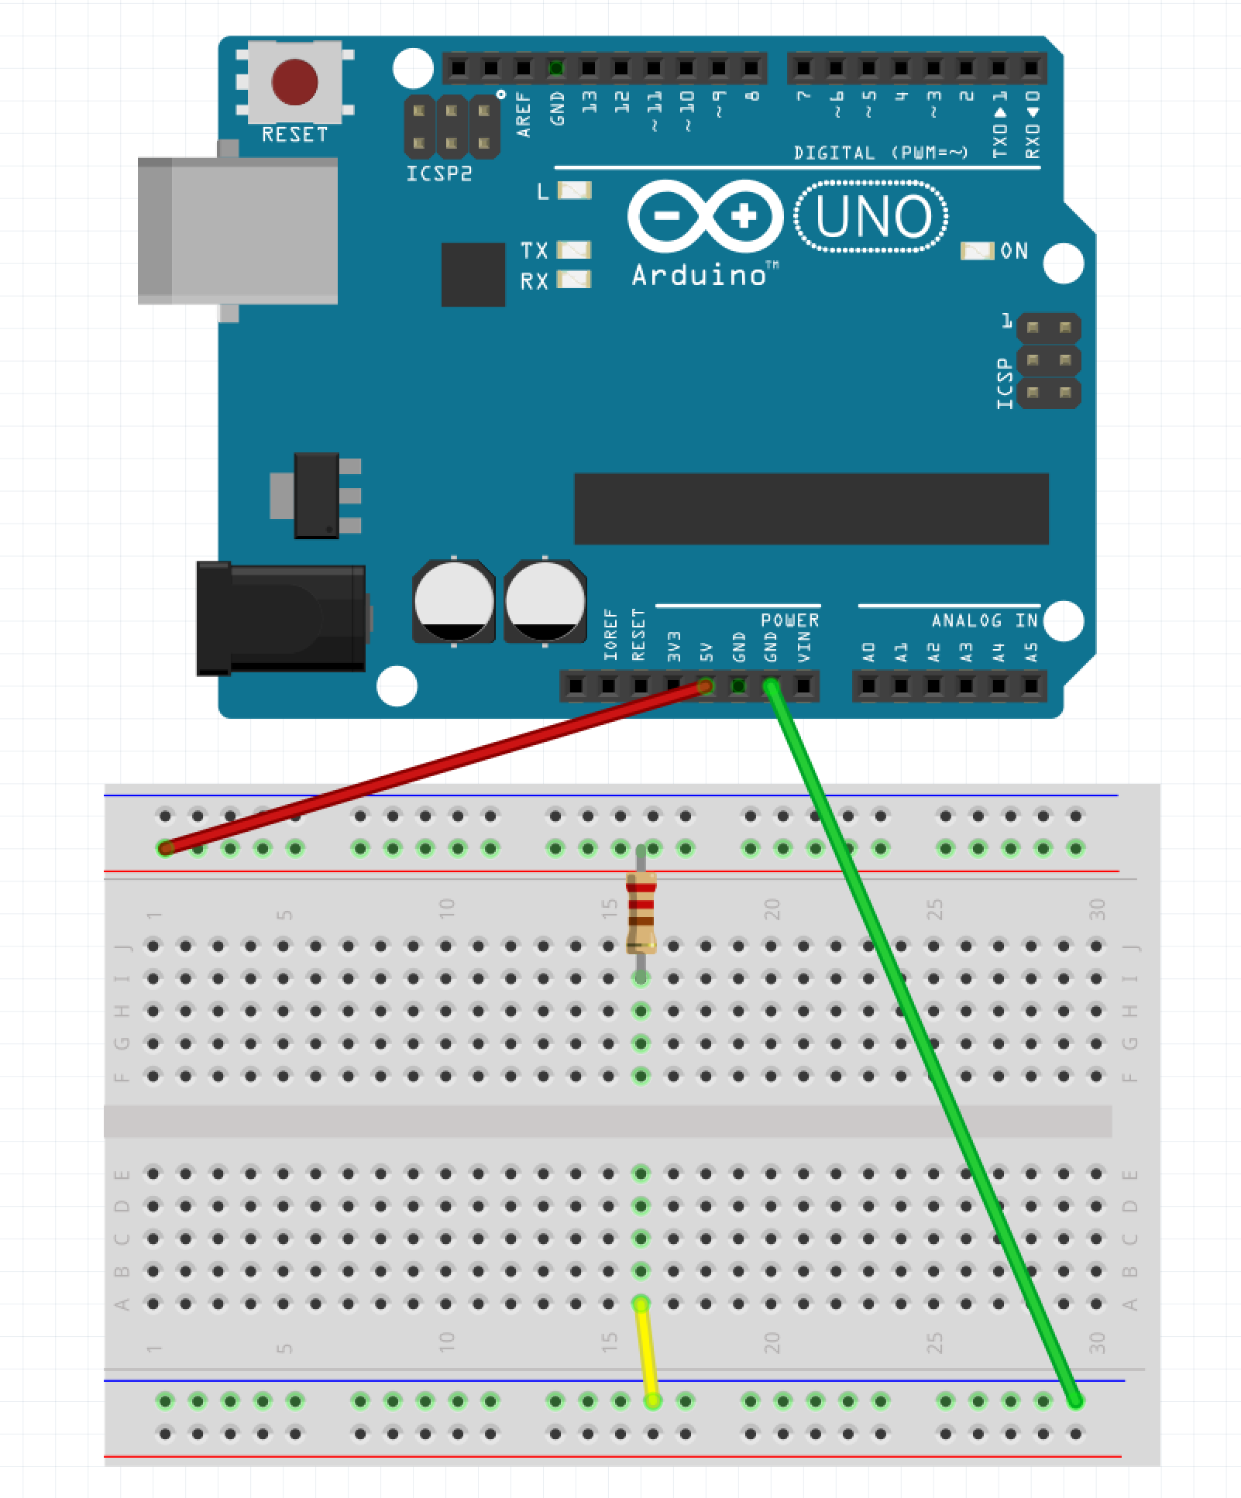
Step 2 – Place Resistor
Run wire from the blue row to A:16 (yellow wire in example)
Place one leg of resistor in the red row and the other in I:16

Slide 12
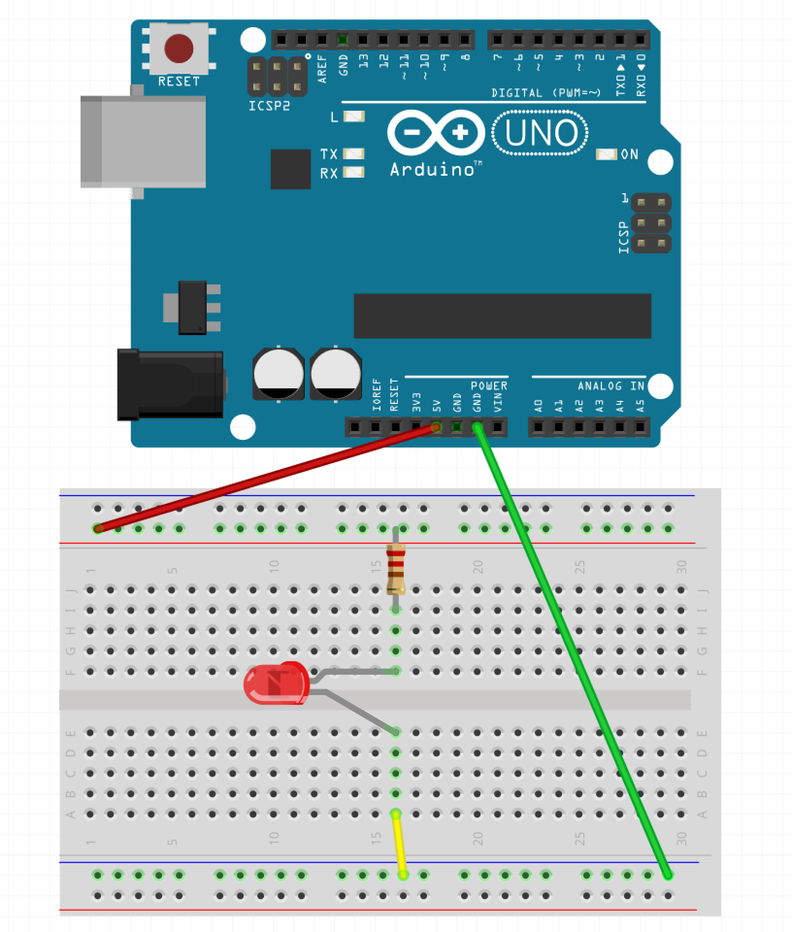
Step 3 – Place LED
Place the longer leg of the LED into F:16
Place the shorter leg of the LED into E:16

Slide 13
Step 4 – Apply Power
Plug the Arduino into the USB Cable
Plug the USB Cable into the PC

Slide 14
So What Just Happened?
Complete Circuit
Arduino acted like a battery
Resistor restricted current flow so LED isn’t damaged

Slide 15
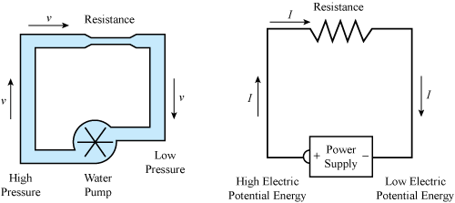
Water Analogy

Slide 16
LEDs

Slide 17
Why is one lead longer?

Slide 18
Project 2 Parts List
Arduino
Breadboard
USB Cable
3 Male-Male wires
1 330 Ohm resistor
1 LED
1 Button

Slide 19

Step 1 – Move the Wires
Make sure the USB Cable is not plugged into the PC
Move the wire plugged into GND on the Arudino from the blue row to J:25 on the breadboard (green wire in the example)
Move the wire plugged into 16:A from the blue row to A:25 (yellow wire in the example)

Slide 20
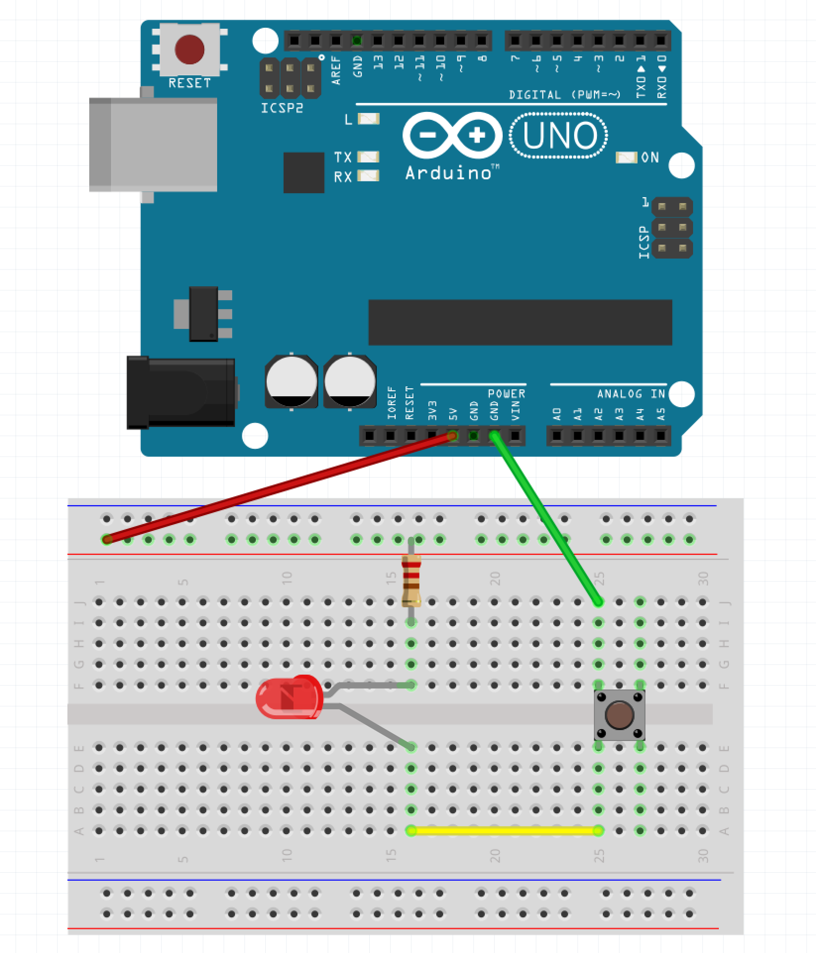
Step 2 – Place the Button
Place the button across the gap

Slide 21
Step 3 – Apply Power
Plug the Arduino into the USB Cable
Plug the USB Cable into the PC

Slide 22
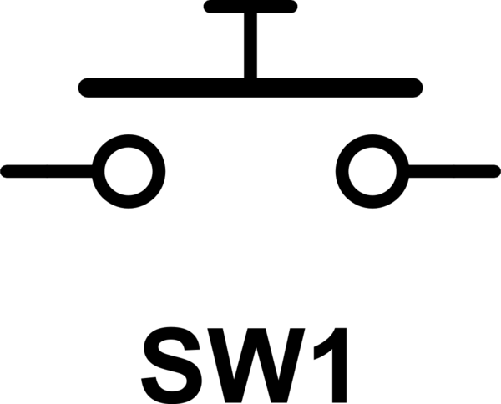
Button as a Switch

Slide 23
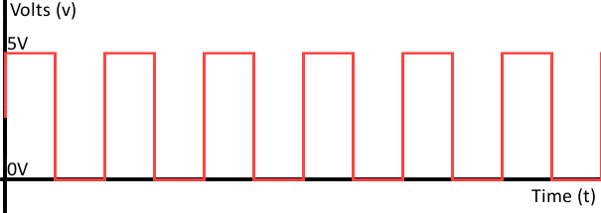
Project 3 - Let’s ’Read’ Something
The Arduino can ‘drive’ pins
The Arduino can also ‘read’ pins
Allows Arduino to ’read’ sensors, collect data, etc.
Need to program the Arduino to make it ‘smart’
The Arduino can set pins to HIGH or LOW
The Arduino can read pins as either HIGH or LOW

Slide 24
Project 3 Parts List
Arduino
Breadboard
USB Cable
1 DHT11 Humidity / Temperature Sensor
3 Male-Female wires

Slide 25
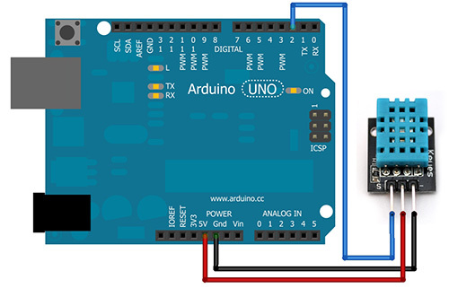
Step 1 - Wiring
Make sure the USB Cable is not plugged into the PC
Place a Male-Female connector running from the GND pin of the Arduino to the negative pin of the DHT11 (black wire in example)
Place a Male-Female connector running from the 5V pin of the Arduino to the middle pin of the DHT11 (red wire in example)
Place a Male-Female connector running from the 2 pin of the Arduino to the ‘S pin of the DHT11 (blue wire in example)

Slide 26
Step 2 – Power the Arduino
Plug the Arduino into the USB Cable
Plug the USB Cable into the PC

Slide 27
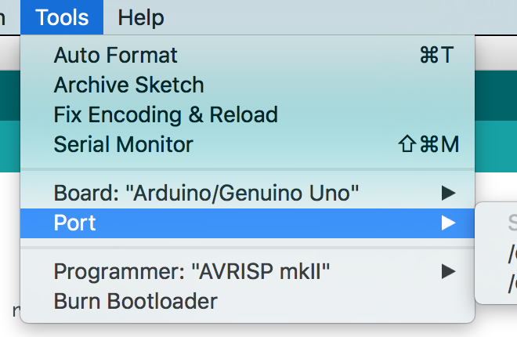
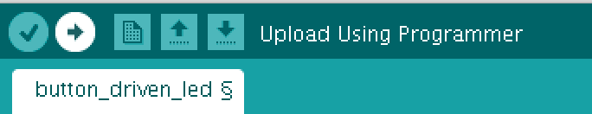
Step 3 – Program the Arduino
Open Sketch dht11.ino in the dht11 directory/folder
Select Tools -> Port
Click the Upload Button

Slide 28
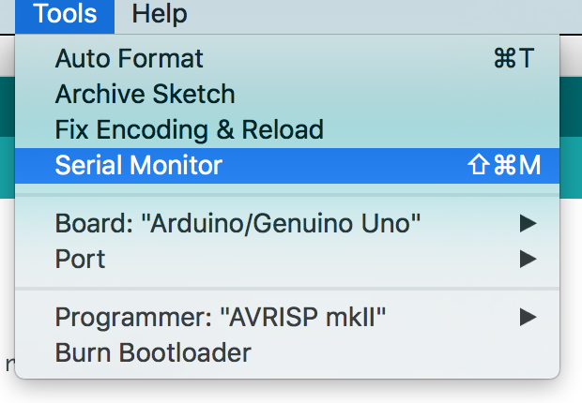
Step 4 – Open the Serial Monitor
Go to Tools and select ‘Serial Monitor’

Slide 29
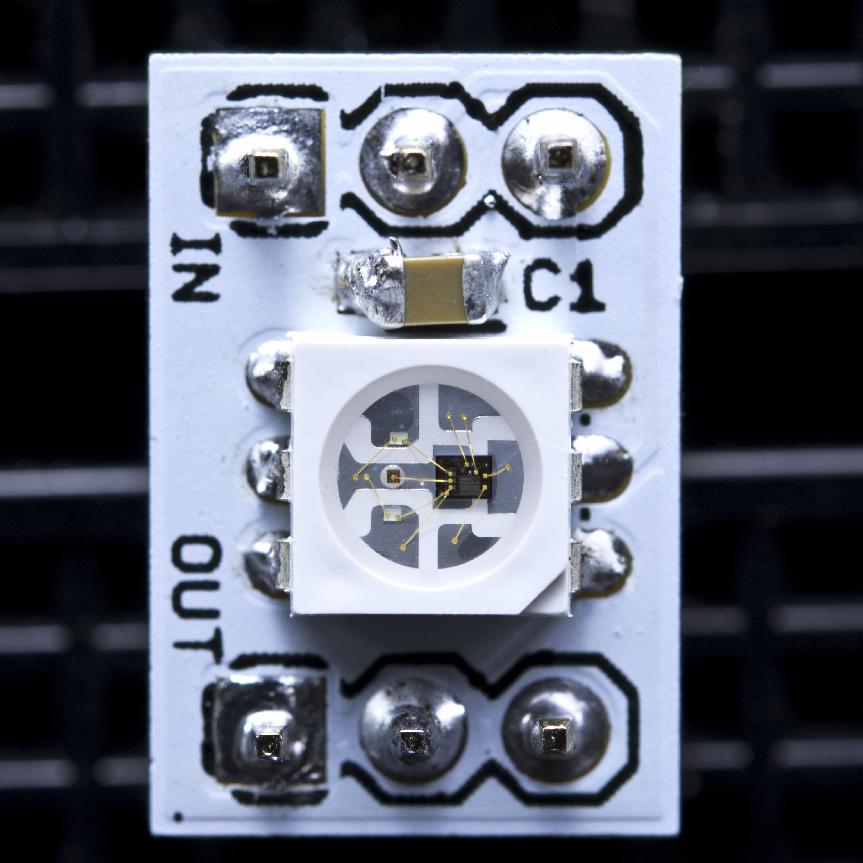
WS2811

Slide 30
Project 4 Parts List
Arduino
Breadboard
USB Cable
1 Neo Pixel Strip with 8 LEDs
1 1000F Capacitor
1 10K Ohm resistor
3 Male-Female wires
9 Male-Male wires

Slide 31
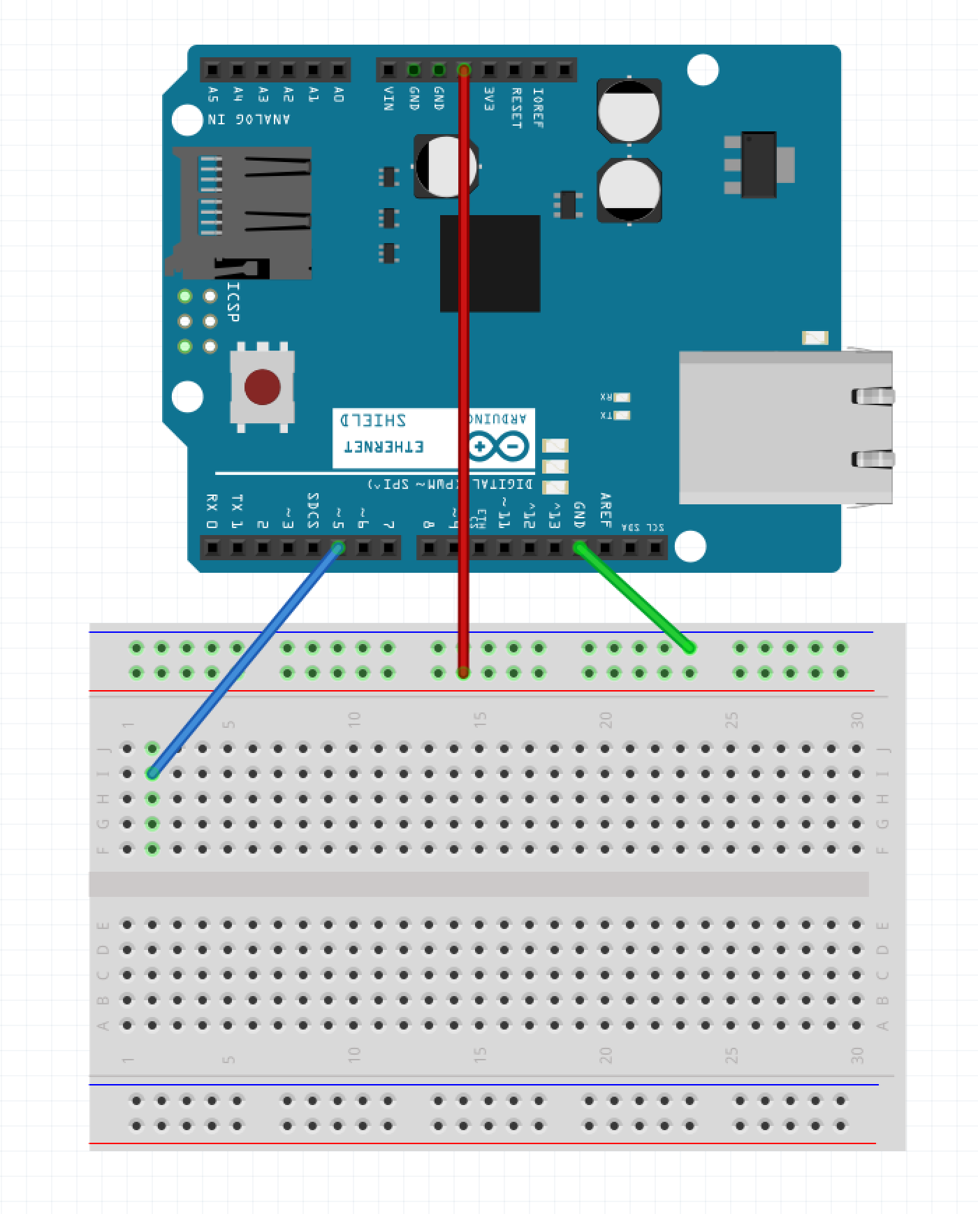
Step 1 – Wire the Rails
Make sure the USB Cable is not plugged into the PC
Run a wire from GND pin on Arduino to blue row on breadboard (green wire in example)
Run a wire from 5V pin on Arduino to red row on breadboard (red wire in example)
Run a wire from pin 5 of the Arduino to I:2 (blue wire in example)

Slide 32
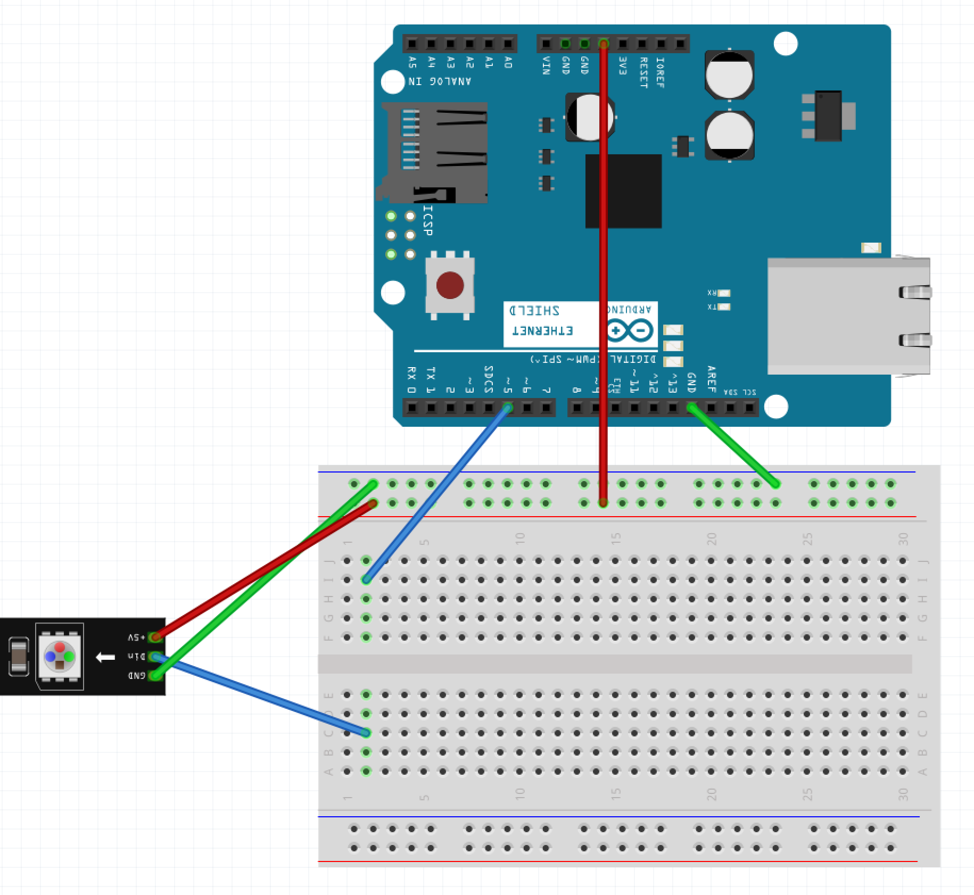
Step 2 – Wire the LED Strip
Run a wire from the Blue Row on breadboard to the GND pin of the LED strip (green wire in example)
Run a wire from the Red Row on breadboard to the 5V pin of the LED strip (red wire in example)
Run a wire from C:2 to the DIn pin of the LED strip (blue wire in example)

Slide 33
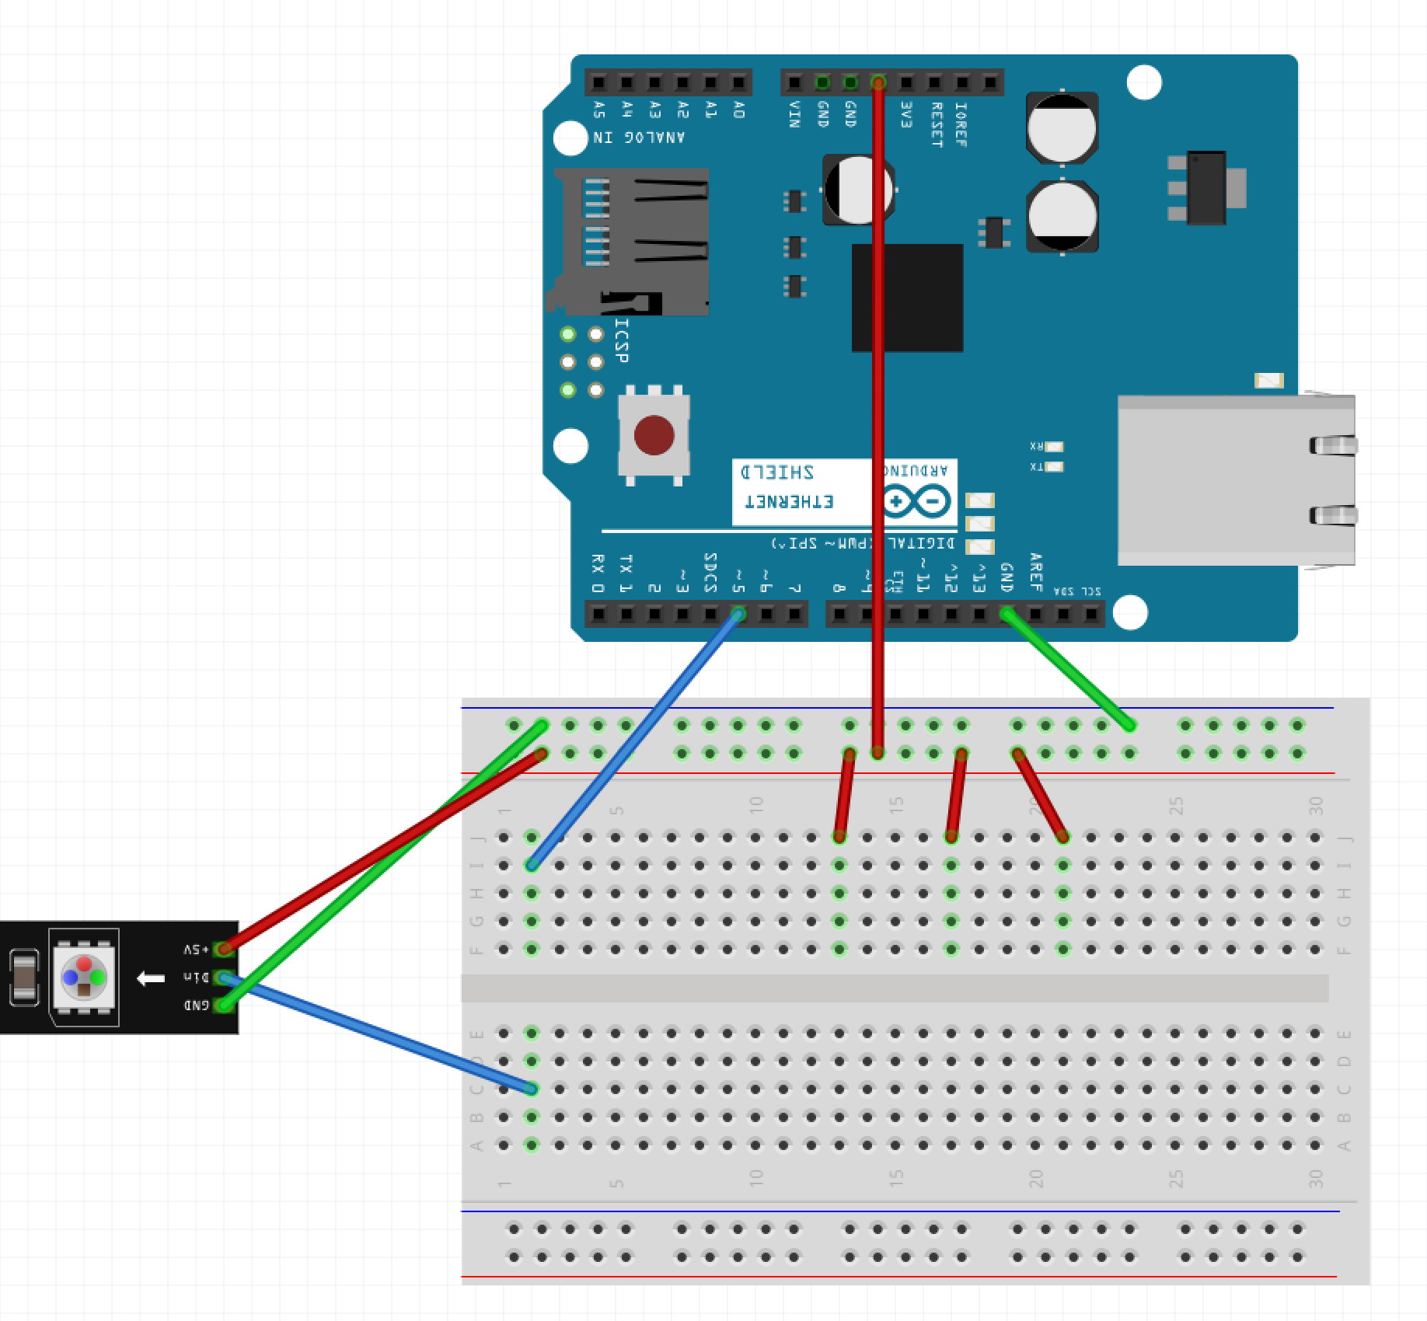
Step 3 – Wire One Side of Button
Run a wire from the Red Row on breadboard to J:13
Run a wire from the Red Row on breadboard to J:17
Run a wire from the Red Row on breadboard to J:21

Slide 34
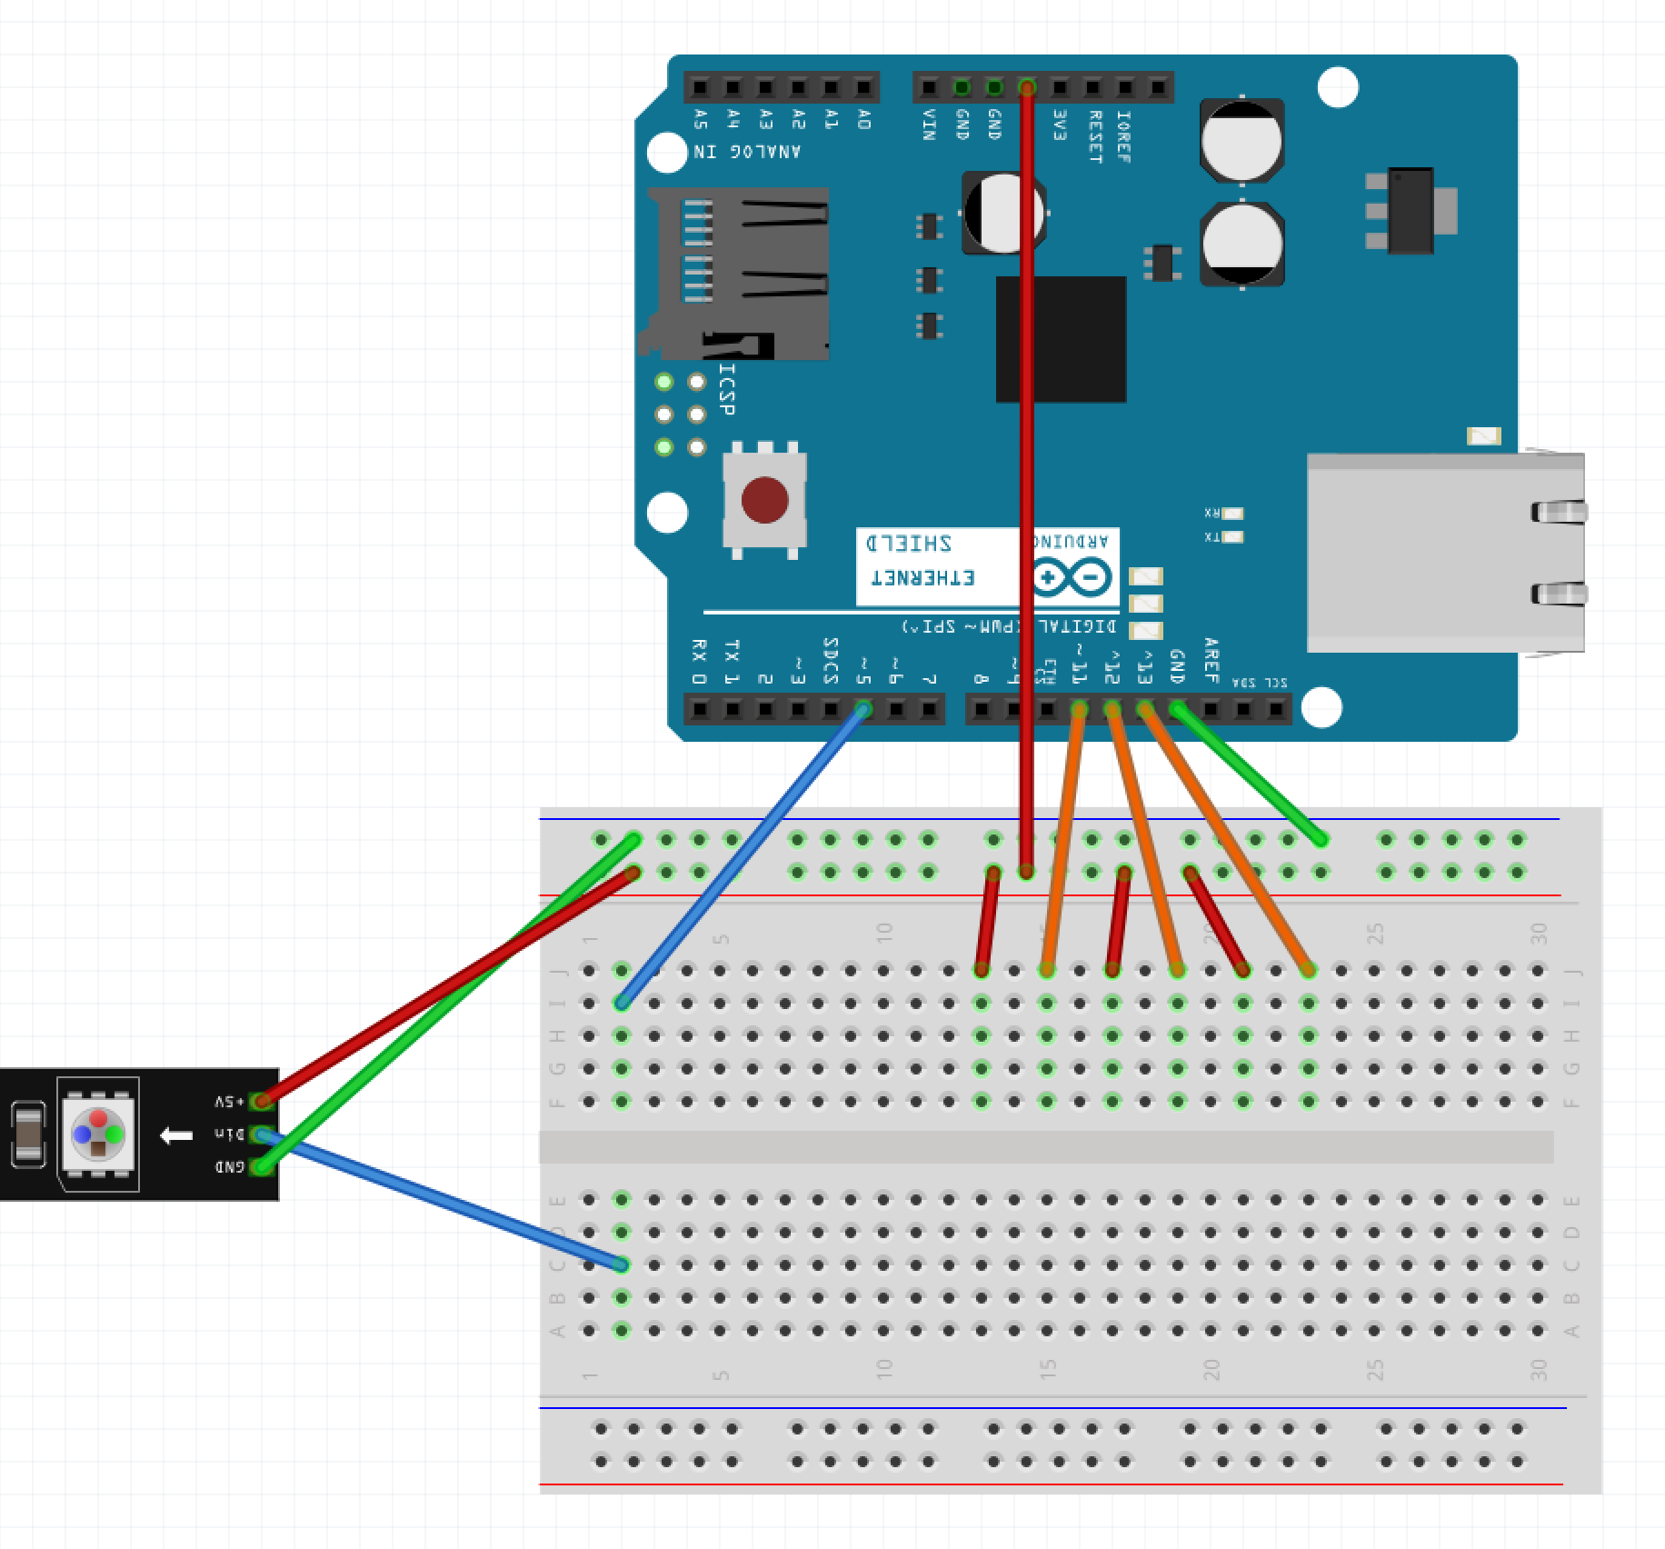
Step 4 – Wire Other Side of Button
Run a wire from pin 11 of the Arudino to J:15
Run a wire from pin 12 of the Arudino to J:19
Run a wire from pin 13 of the Arudino to J:23

Slide 35
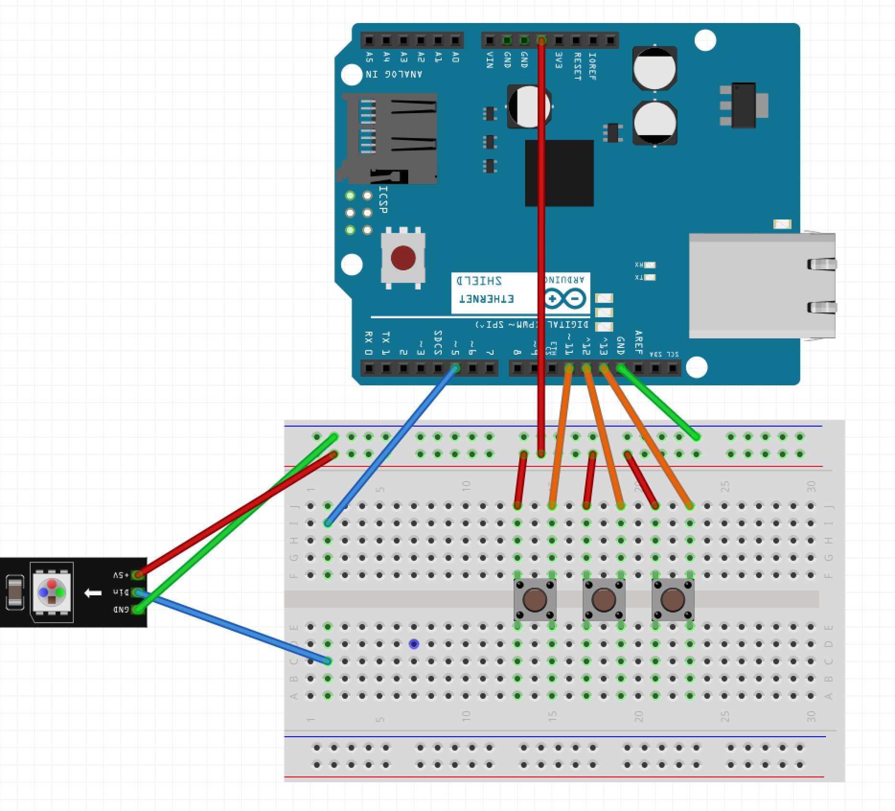
Step 5 – Button Placement
Place the 3 buttons
One in F:13 and F:15
One in F:17 and F:19
One in F:21 and F:23

Slide 36
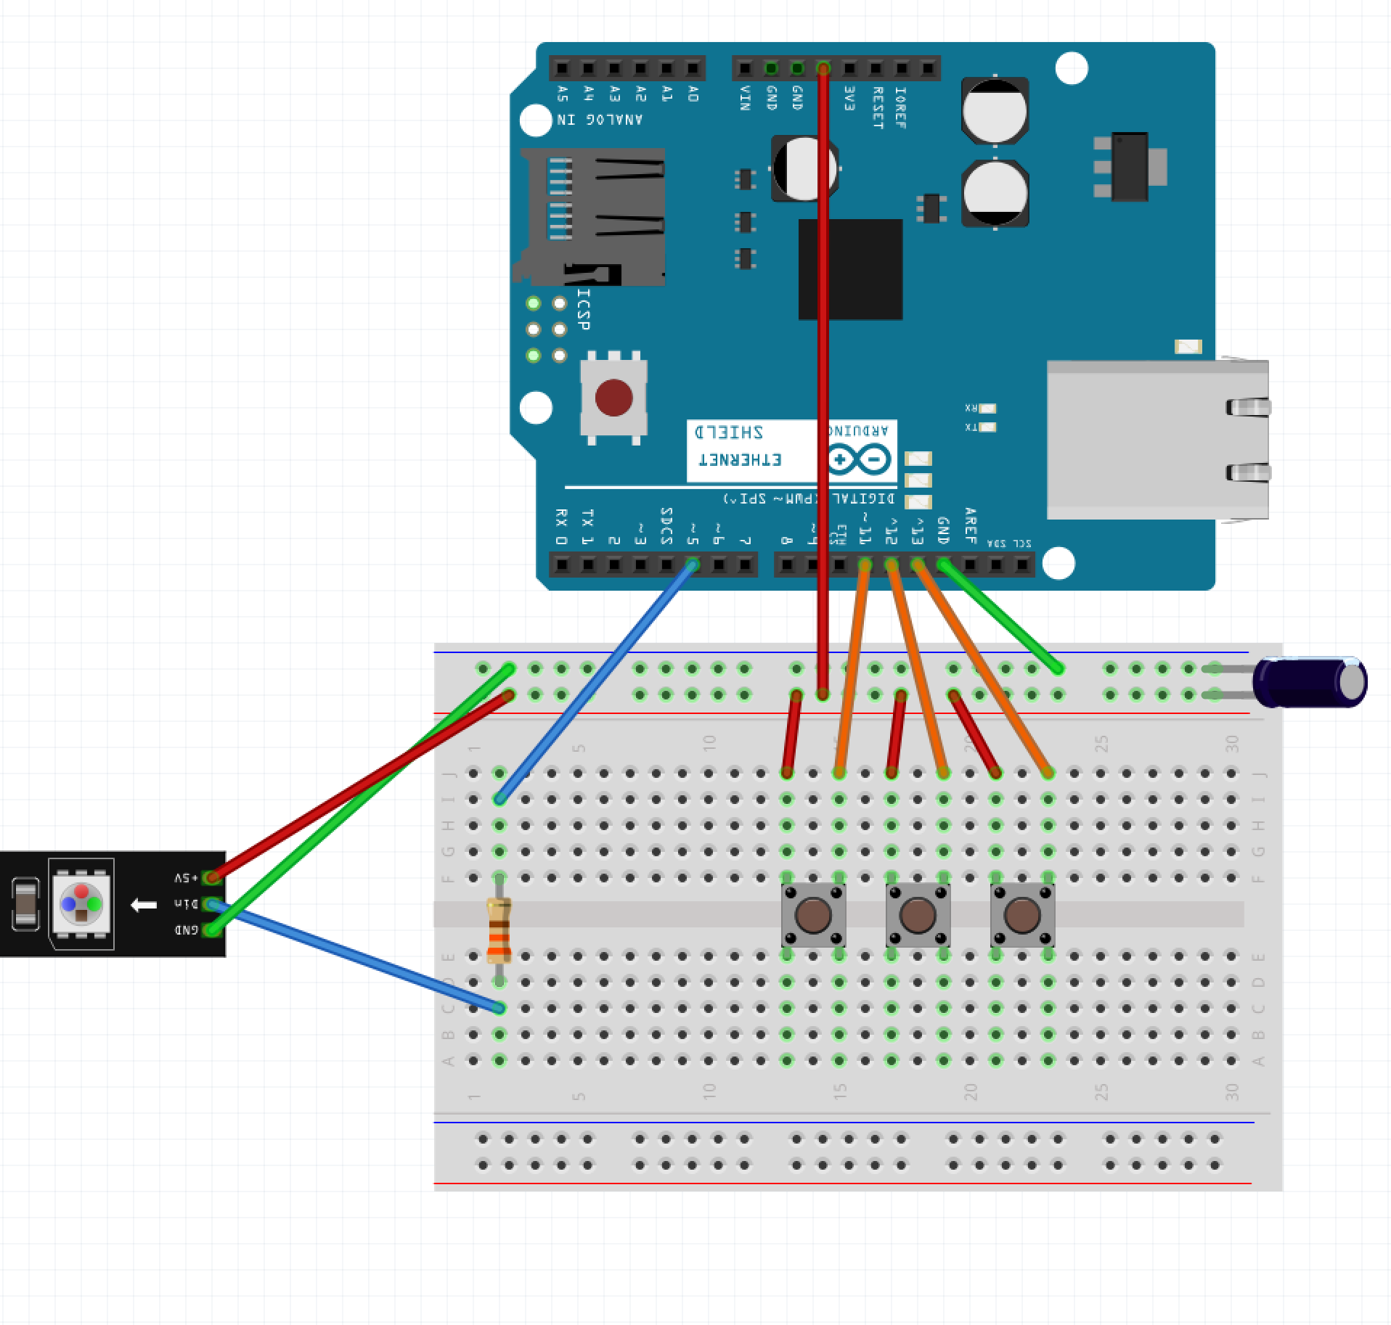
Step 6 – Components
Place the Resistor over the gap on F:2 and D:2
Place the capacitor with the long leg in the Red Row and the short leg in the Blue Row

Slide 37
Step 7 – Power the Arduino
Plug the Arduino into the USB Cable
Plug the USB Cable into the PC

Slide 38
Step 8 – Program the Arduino
Open Sketch button_driven_led.ino in the button_drive_led directory/folder
Select Tools -> Port
Click the Upload Button

Slide 39
What Next?
Guided Learning in Kits / Books
Online Tools
Spark Fun - https://www.sparkfun.com/
What you can do when you got it all down: https://youtu.be/ahpPqD7Ju5w?t=17s

